Slide 1
PUK: Simulating Cyclic Voltammograms
Marcus Nørgaard Weng, 5. år Nanoscience

Slide 2
Oversigt
Introduction
Reactions
DFT training data
Methods
Predicting binding energies
Predicting energies of simulated surfaces
Surface binding energies to voltammogram
Simulating surface adsorbates while varying voltage
Modeling neighbour-interactions
Modeling hysteresis
Results
Predicting binding energies of adsorbates
Predicting energies of simulated surfaces
Surface binding energies to voltammogram
Simulating surface adsorbates while varying voltage
Conclusion

Slide 3
Oversigt
Introduction
Reactions
DFT training data
Methods
Predicting binding energies
Predicting energies of simulated surfaces
Surface binding energies to voltammogram
Simulating surface adsorbates while varying voltage
Modeling neighbour-interactions
Modeling hysteresis
Results
Predicting binding energies of adsorbates
Predicting energies of simulated surfaces
Surface binding energies to voltammogram
Simulating surface adsorbates while varying voltage
Conclusion

Slide 4
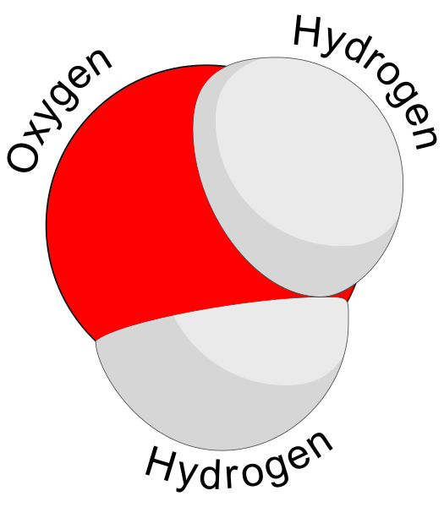
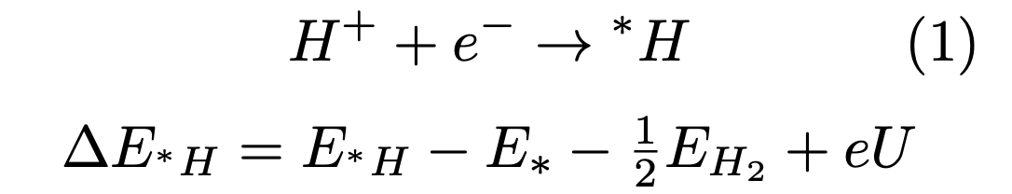
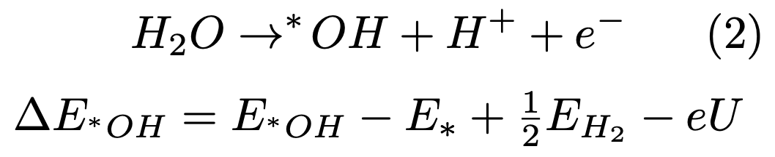
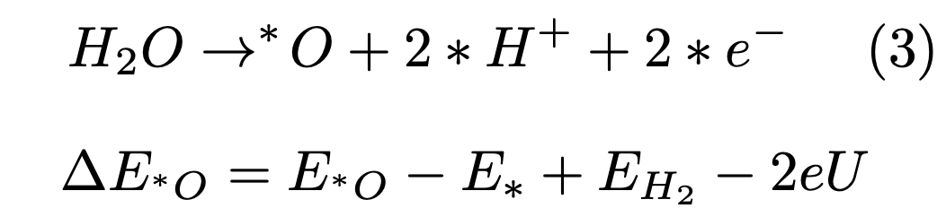
Introduction – Reactions
Motivation:
Find good catalysts for catalysing important chemical processes for eg. fuel cell reactions
System:
Aqueous solution
Reversible Hydrogen Electrode

Slide 5
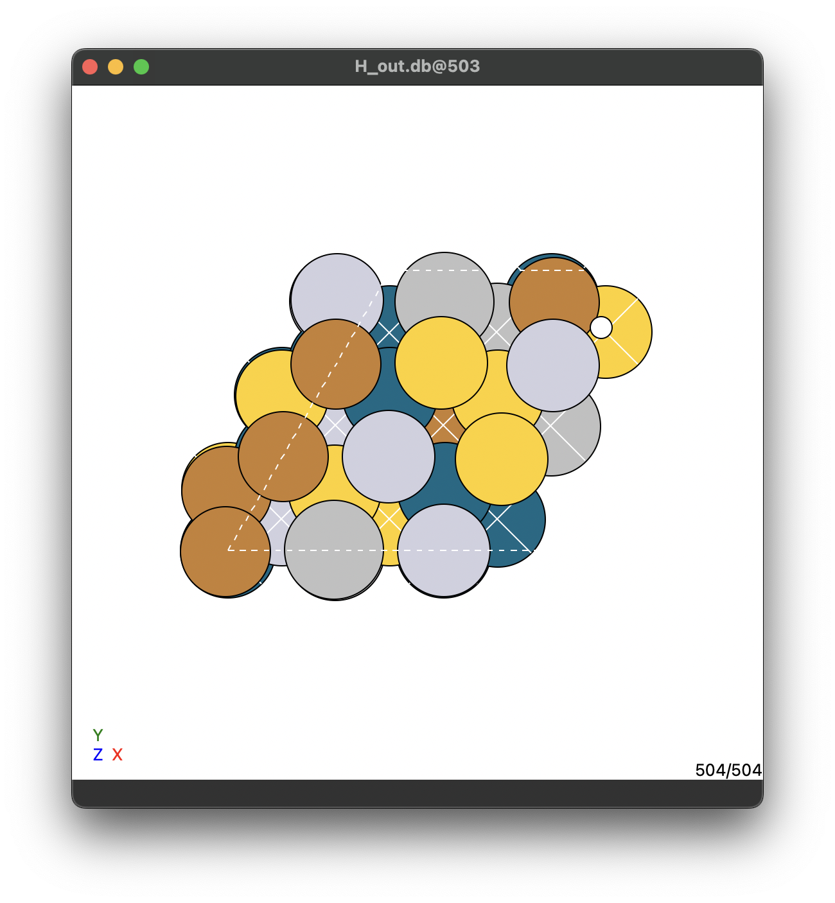
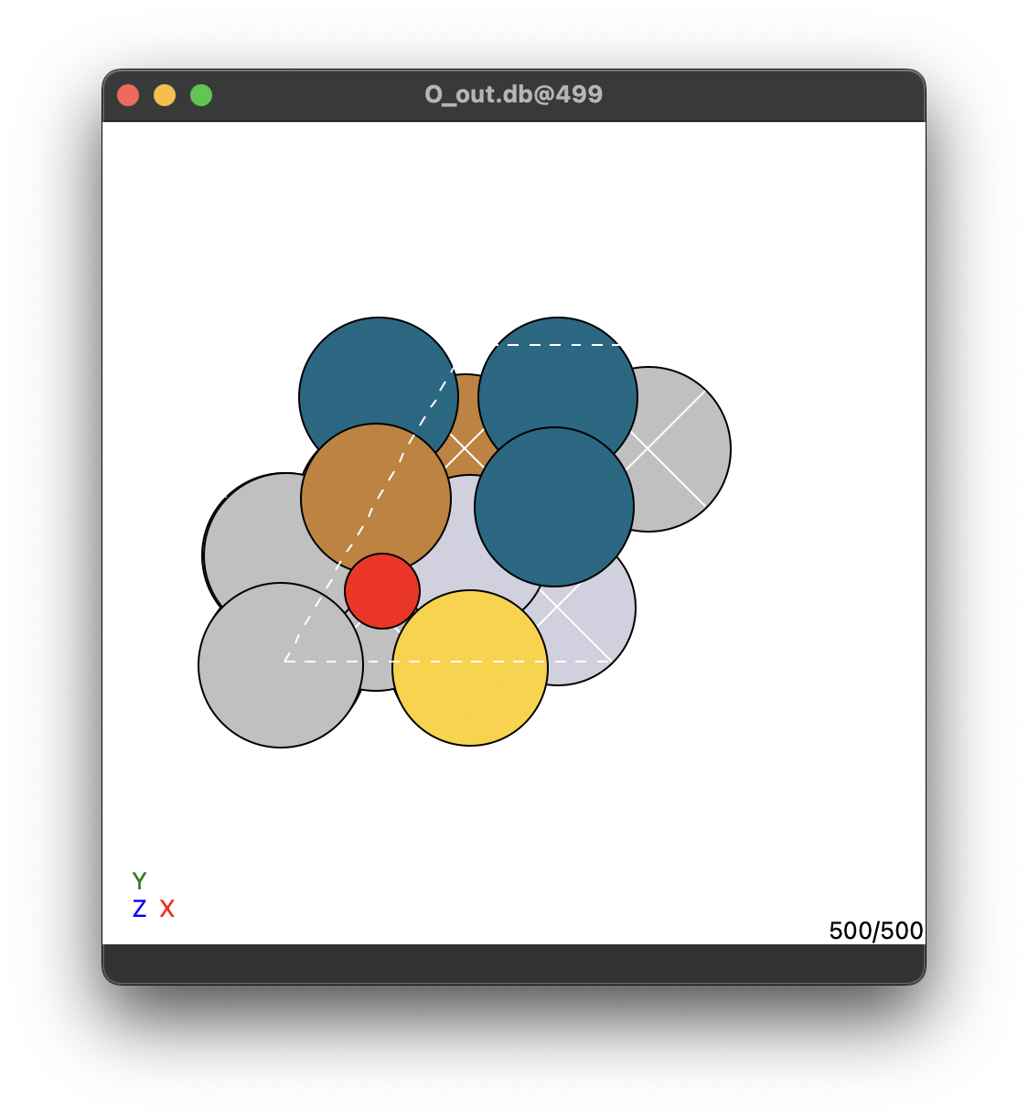
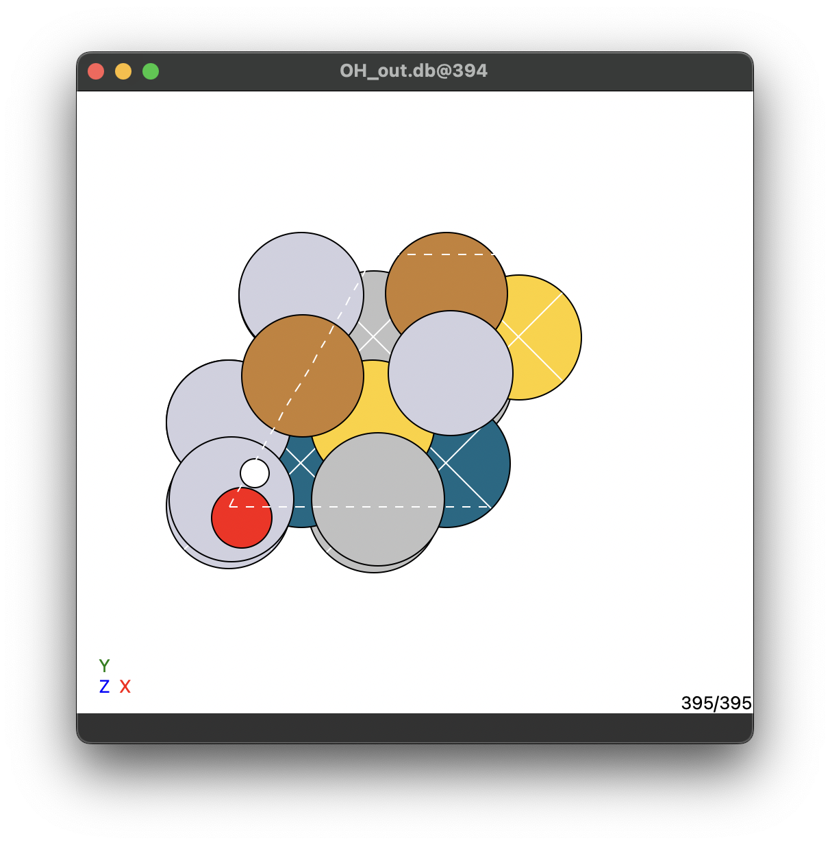
Introduction – DFT data
H_out.db | O_out.db | OH_out.db
56 slabs | 500 slabs | 395 slabs
9 site/slab | 1 site/slab | 1 site/slab
504 total slabs | 500 total slabs | 395 total slabs
* Data fra Jack Kirk Pedersen

Slide 6
Oversigt
Introduction
Reactions
DFT training data
Methods
Predicting binding energies
Predicting energies of simulated surfaces
Surface binding energies to voltammogram
Simulating surface adsorbates while varying voltage
Modeling neighbour-interactions
Modeling hysteresis
Results
Predicting binding energies of adsorbates
Predicting energies of simulated surfaces
Surface binding energies to voltammogram
Simulating surface adsorbates while varying voltage
Conclusion

Slide 7
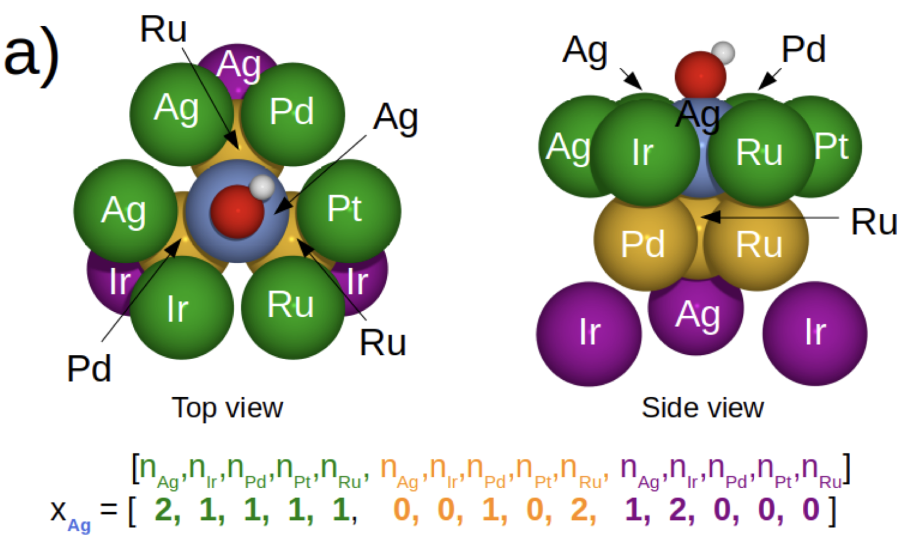
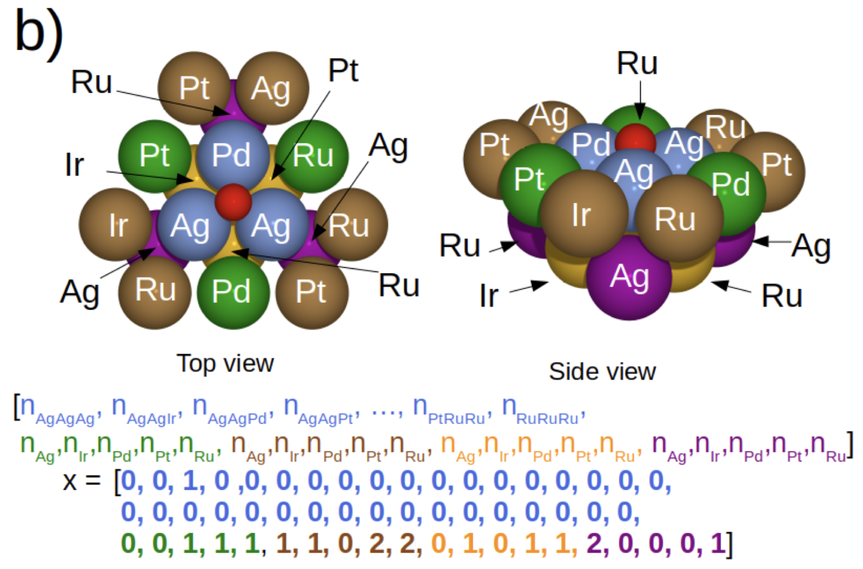
Methods – Predicting binding energies
Label:
Energy
On-top slab
*
Input:
Regression algorithm
Feature vector
Label:
Energy
Hollow-site slab
Input:
Regression algorithm
Feature vector
*Christian M Clausen et al. “What Atomic Positions Determines Re- activity of a Surface? Long-Range, Directional Ligand Effects in Metallic Alloys”. In: Advanced Science 8.9 (2021), p. 2003357.

Slide 8
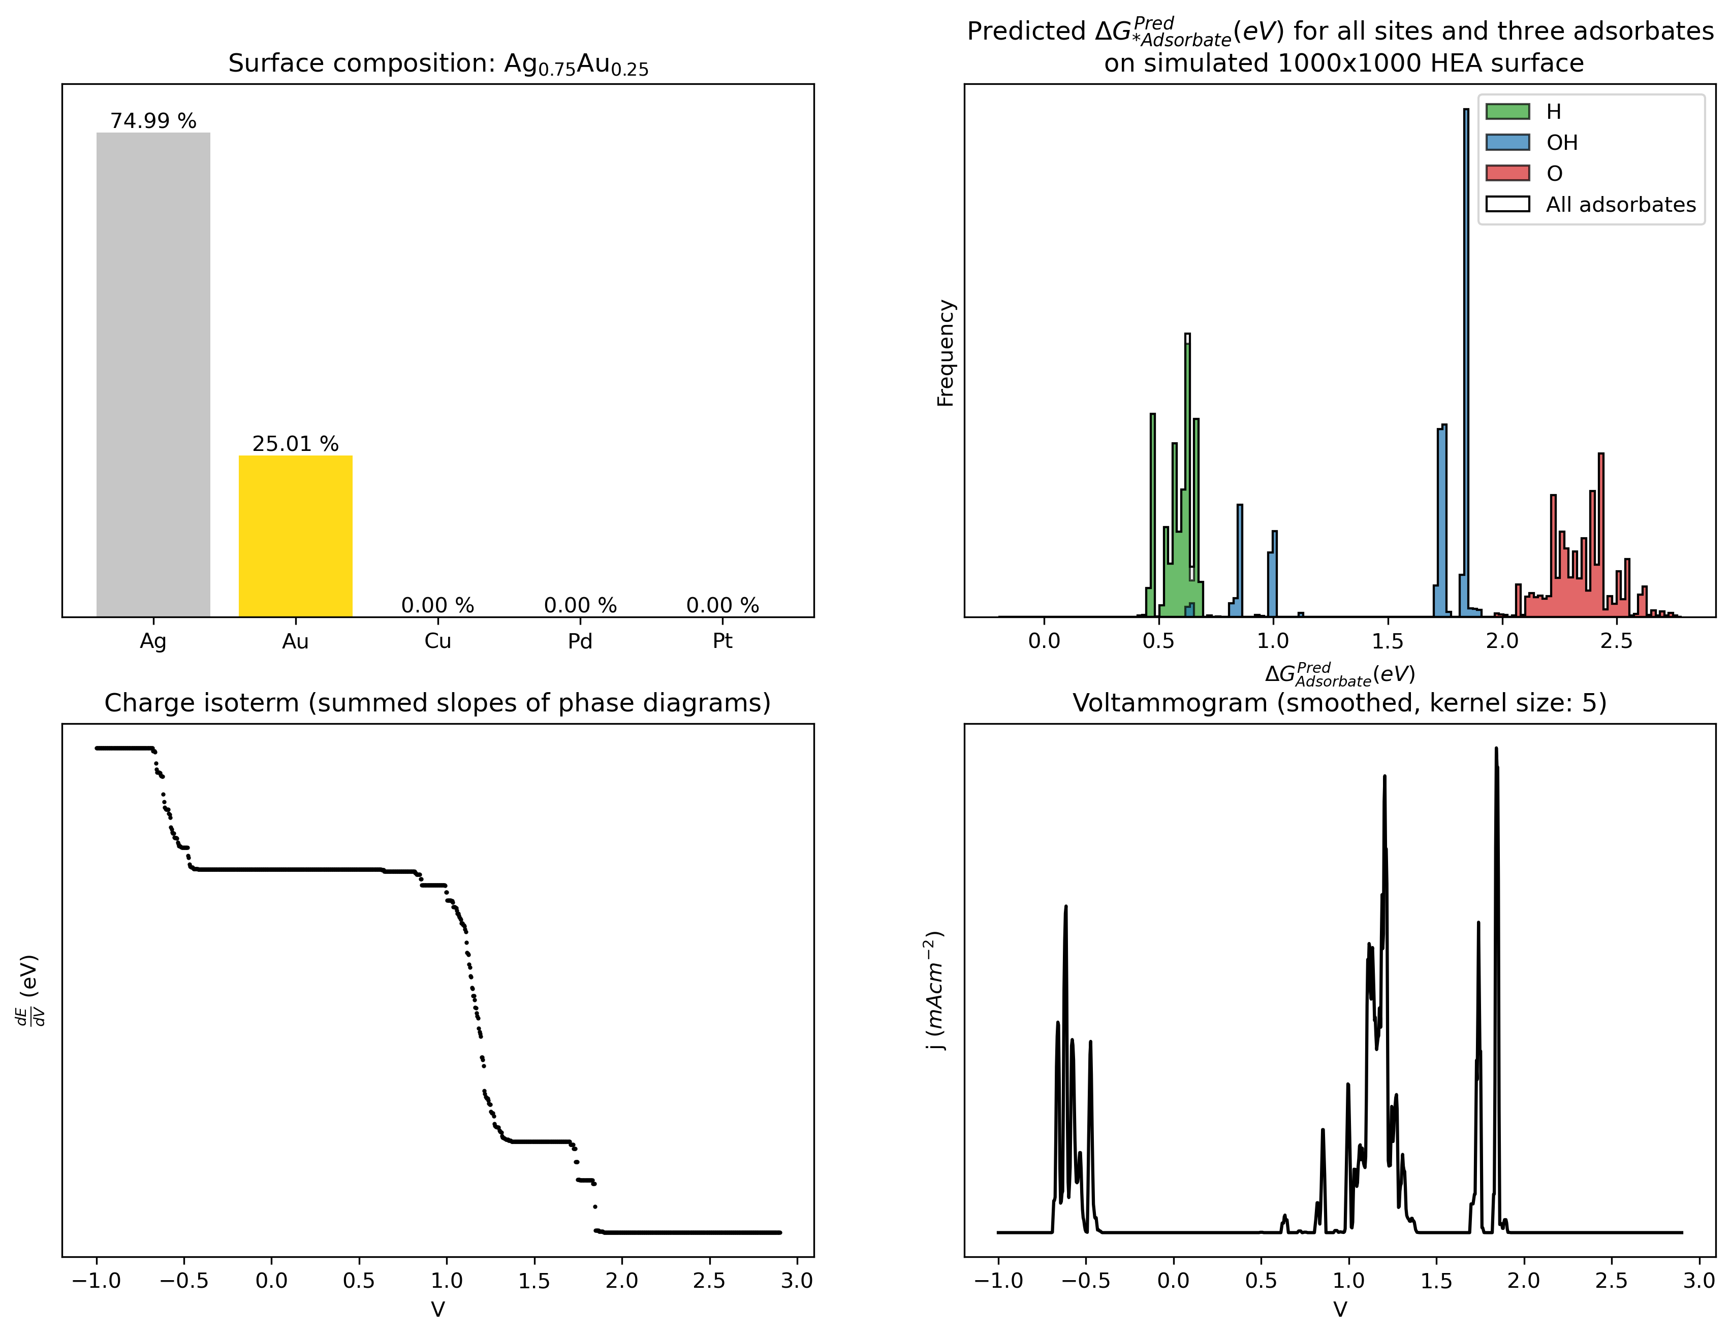
Methods – Predicting energies of simulated surfaces
Simulating surface
[Au, Ag]
1000
[25, 75]
= hollow FCC site
= on-top site
1st layer of surface shown
Predicted energies
Regression algorithm
Feature vectors

Slide 9
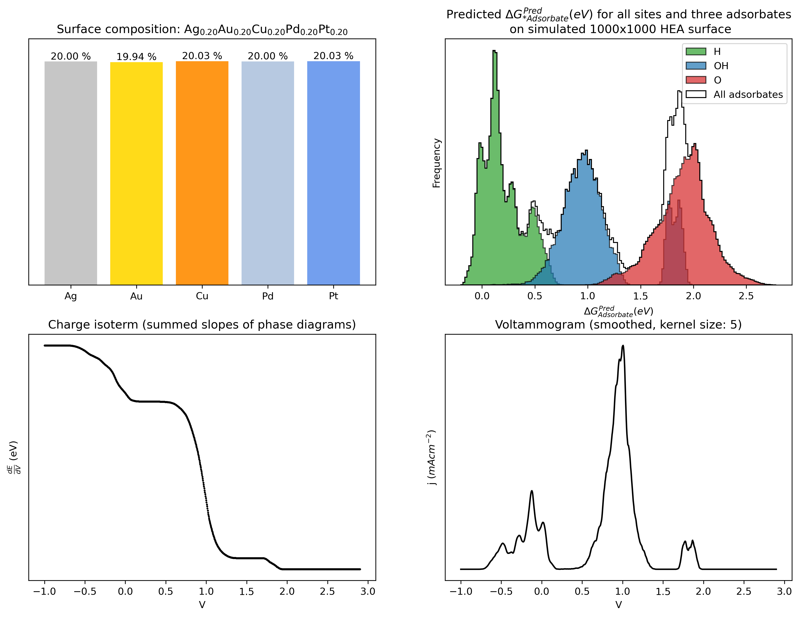
Methods – Predicting energies of simulated surfaces
Simulate surface
Feature vectors
Predict energies
Plotting
Choose:
Metals
Split
Size

Slide 10
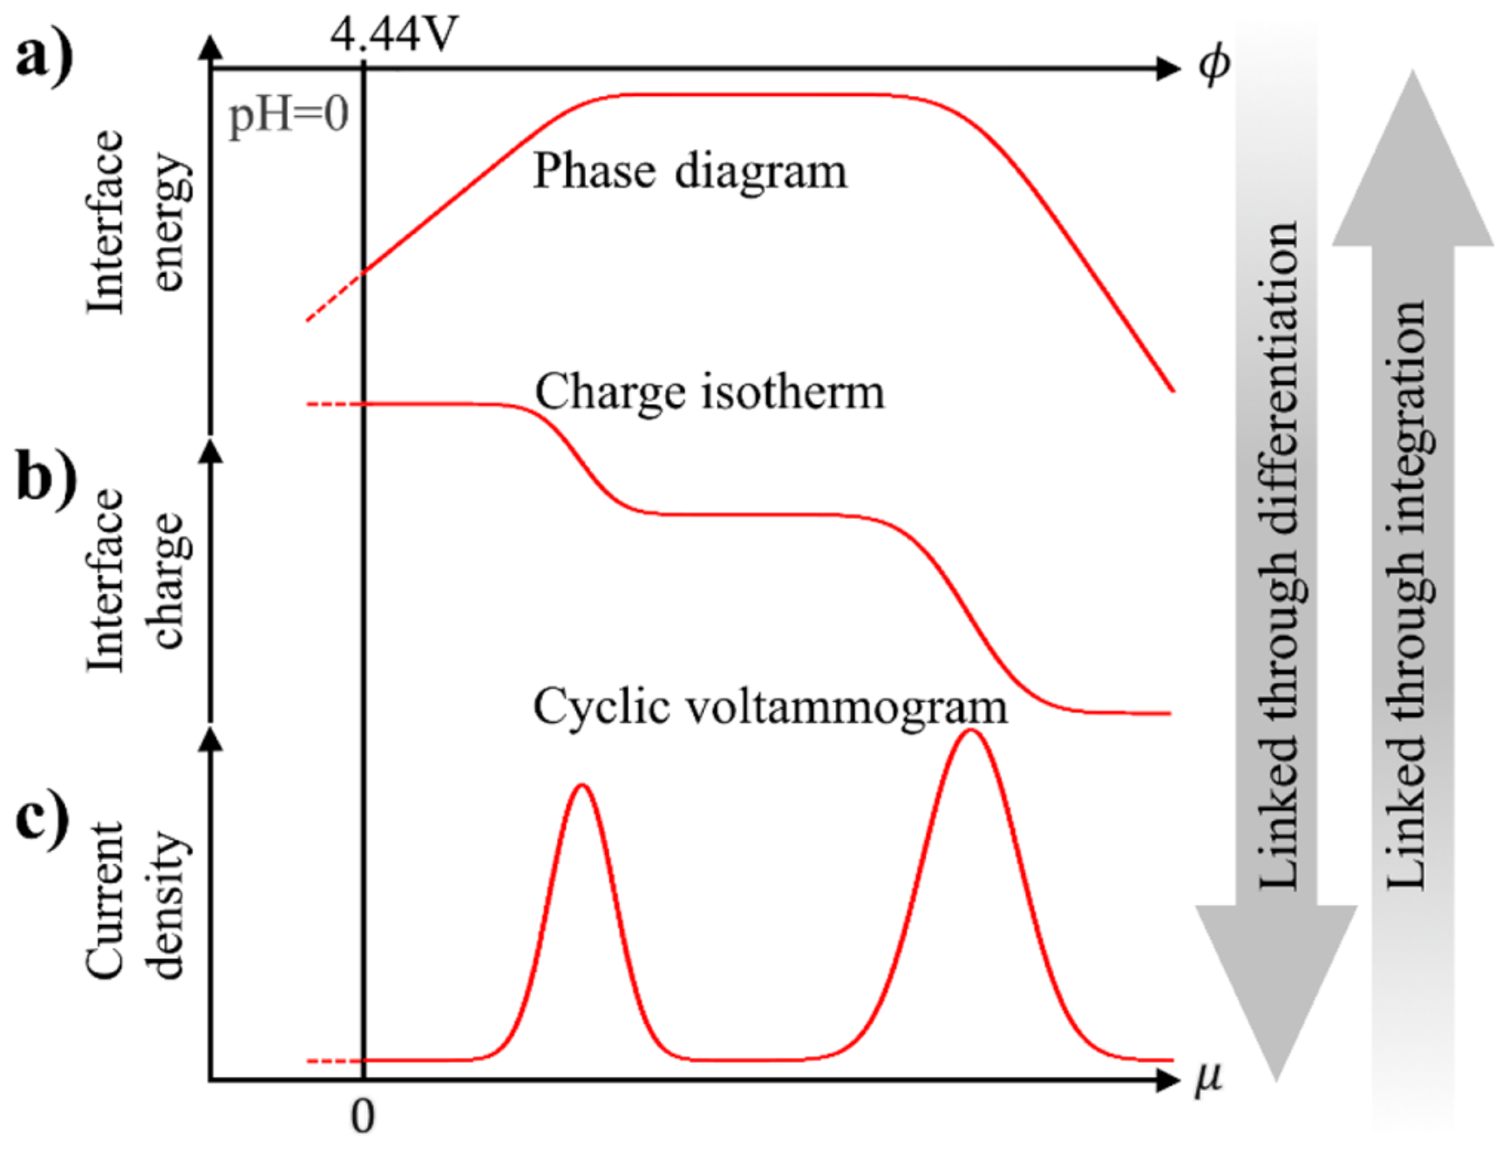
Methods – Surface binding energies to voltammogram
Source: Jan Rossmeisl et al. “Realistic cyclic voltammograms from ab initio simulations in alkaline and acidic electrolytes”. In: The Journal of Physical Chemistry C 124.37 (2020), pp. 20055–20065.

Slide 11
Methods – Surface binding energies to voltammogram
0
Interface energy
Voltage
Source: Jan Rossmeisl et al. “Realistic cyclic voltammograms from ab initio simulations in alkaline and acidic electrolytes”. In: The Journal of Physical Chemistry C 124.37 (2020), pp. 20055–20065.

Slide 12
Methods – Surface binding energies to voltammogram
0
Interface energy
Voltage
1
0
-1
Interface charge
-2
Voltage
Source: Jan Rossmeisl et al. “Realistic cyclic voltammograms from ab initio simulations in alkaline and acidic electrolytes”. In: The Journal of Physical Chemistry C 124.37 (2020), pp. 20055–20065.

Slide 13
Methods – Surface binding energies to voltammogram
1
0
-1
Interface charge
-2
Voltage
Source: Jan Rossmeisl et al. “Realistic cyclic voltammograms from ab initio simulations in alkaline and acidic electrolytes”. In: The Journal of Physical Chemistry C 124.37 (2020), pp. 20055–20065.

Slide 14
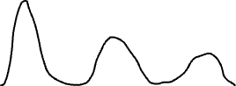
Methods – Surface binding energies to voltammogram
1
0
-1
Interface charge
-2
Voltage
Current density
Voltage
Source: Jan Rossmeisl et al. “Realistic cyclic voltammograms from ab initio simulations in alkaline and acidic electrolytes”. In: The Journal of Physical Chemistry C 124.37 (2020), pp. 20055–20065.

Slide 15
Methods – Surface binding energies to voltammogram
Current density
Voltage
Source: Jan Rossmeisl et al. “Realistic cyclic voltammograms from ab initio simulations in alkaline and acidic electrolytes”. In: The Journal of Physical Chemistry C 124.37 (2020), pp. 20055–20065.

Slide 16
Methods – Simulating surface adsorbates while varying voltage
Things not modelled in the previous method:
Circular voltage sweep
Ability to model effects
Hysteresis
Neighbour-interactions
Voltage
Circular sweep
Notes:
The previous cyclic voltammogram method does not account for effects seen in experimental data, such as hys- teresis and neighbour interactions. A second method where these effects are approximated is used. In this sec- ond method a linear sweep or circular sweep in voltage made, while concur- rently keeping track of the adsorbates on the surface and the summed bid- ing energies (∆G) of the adsorbates at each voltage.

Slide 17
Methods – Simulating surface adsorbates while varying voltage
Algorithm
Predict all energies on all sites
All three adsorbates
For voltage in voltage range:
Loop through all adsorbates:
Account for steric hindrance, if neighbours
If binding energy > Hysteresis energy barrier: Remove
Loop through the smallest energies:
Check for emptiness on the site
Account for steric hindrance, if neighbours
If binding energy < 0: Adsorb
Continue adsorbing until lowest energy > 0
Save the summed binding energies of all adsorbates divided by total number of atoms
Voltage
Circular sweep
Notes:
The previous cyclic voltammogram method does not account for effects seen in experimental data, such as hys- teresis and neighbour interactions. A second method where these effects are approximated is used. In this sec- ond method a linear sweep or circular sweep in voltage made, while concur- rently keeping track of the adsorbates on the surface and the summed bid- ing energies (∆G) of the adsorbates at each voltage.

Slide 18
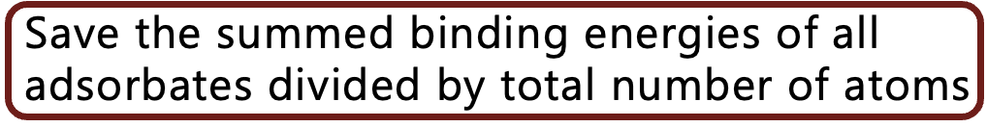



Methods – Simulating surface adsorbates while varying voltage
Phase diagram
0
Interface energy
Voltage

Slide 19
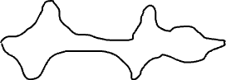
Methods – Simulating surface adsorbates while varying voltage
Phase diagram
0
Interface energy
Voltage
Double differentiation
Circular voltammogram
0
Current density
Voltage

Slide 20
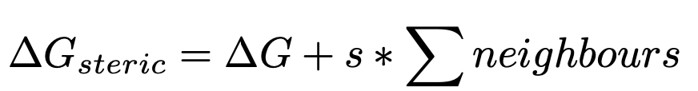
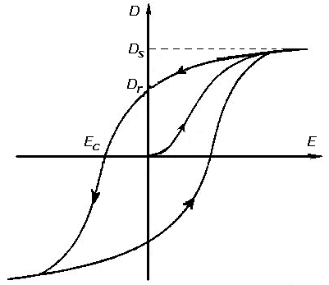
Methods – Modelling hysteresis and steric hindrance
Steric hindrance
Hysteresis
Sites with no or few neighbour adsorbates are energetically favourable
Phenomenon:
Adsorbates desorb at a higher energy than they adsorb
Phenomenon:
Model/
Approximation:
Add a small bonus energy to the selected site for each close neighbour
Model/
Approximation:
Adsorbates are adsorbed at negative binding energies but only desorbed at a higher energy
= close neighbour

Slide 21
Oversigt
Introduction
Reactions
DFT training data
Methods
Predicting binding energies
Predicting energies of simulated surfaces
Surface binding energies to voltammogram
Simulating surface adsorbates while varying voltage
Modeling neighbour-interactions
Modeling hysteresis
Results
Predicting binding energies of adsorbates
Predicting energies of simulated surfaces
Surface binding energies to voltammogram
Simulating surface adsorbates while varying voltage
Conclusion

Slide 22
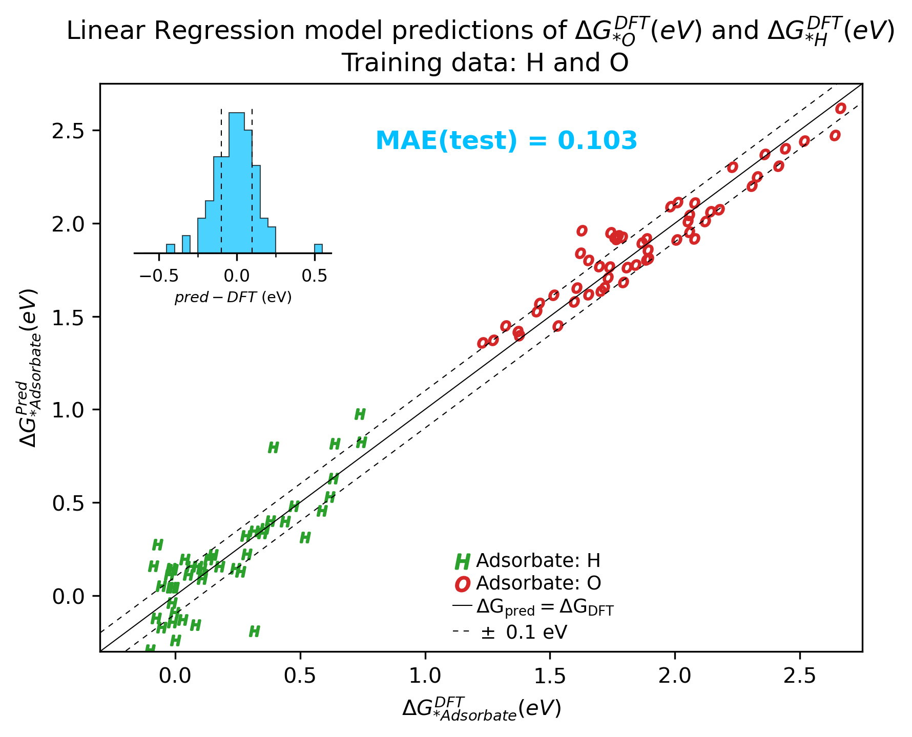
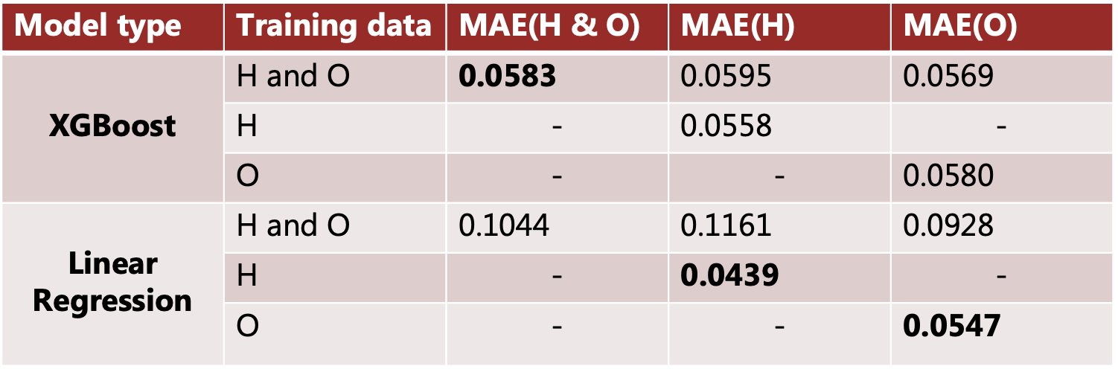
Results - Predicting binding energies of adsorbates
Slabs
Regression algorithm
80 % training data
10 % validation data
+
10 % test data
Energy

Slide 23
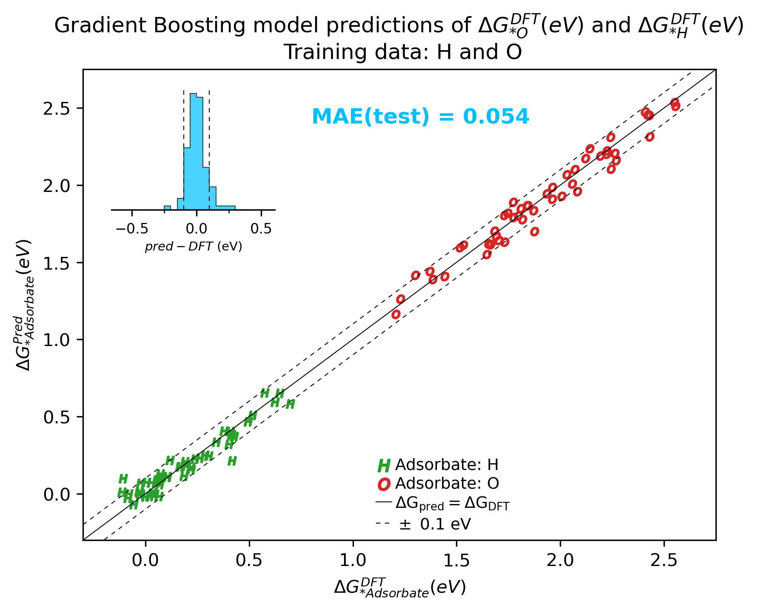
Results - Predicting binding energies of adsorbates
Slabs
Regression algorithm
80 % training data
10 % validation data
+
10 % test data
Energy

Slide 24
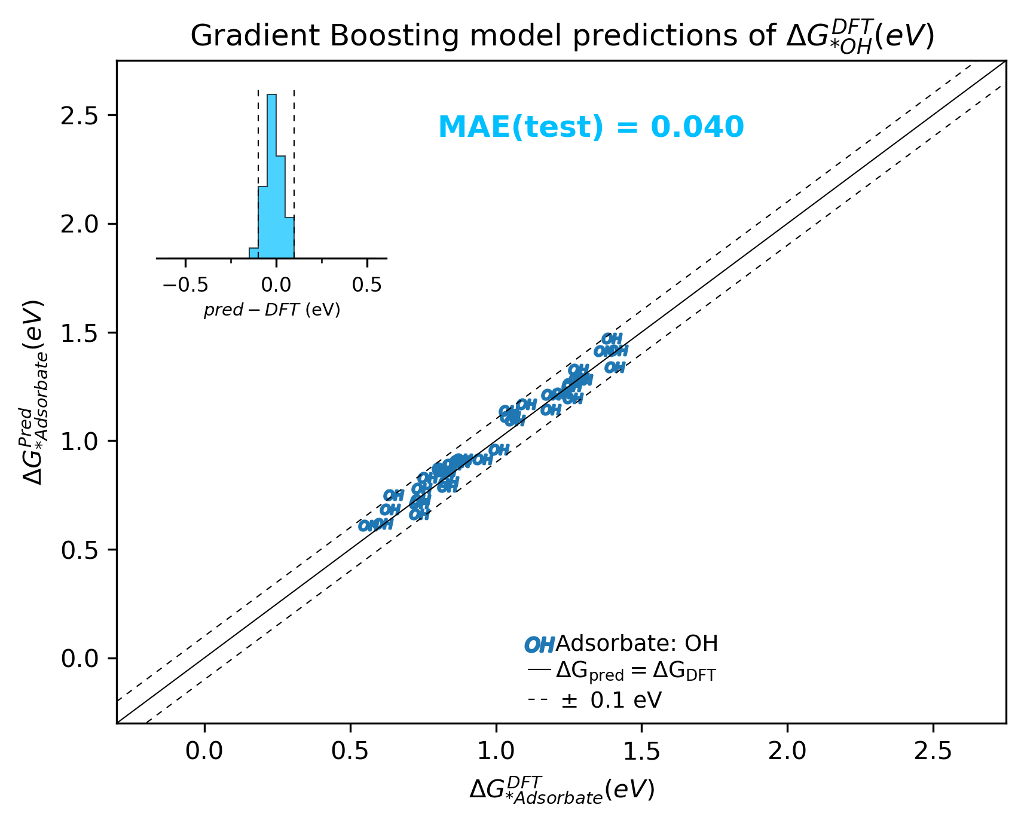
Results - Predicting binding energies of adsorbates
Slabs
Regression algorithm
80 % training data
10 % validation data
+
10 % test data
Energy

Slide 25
Results - Predicting energies of simulated surfaces

Slide 26
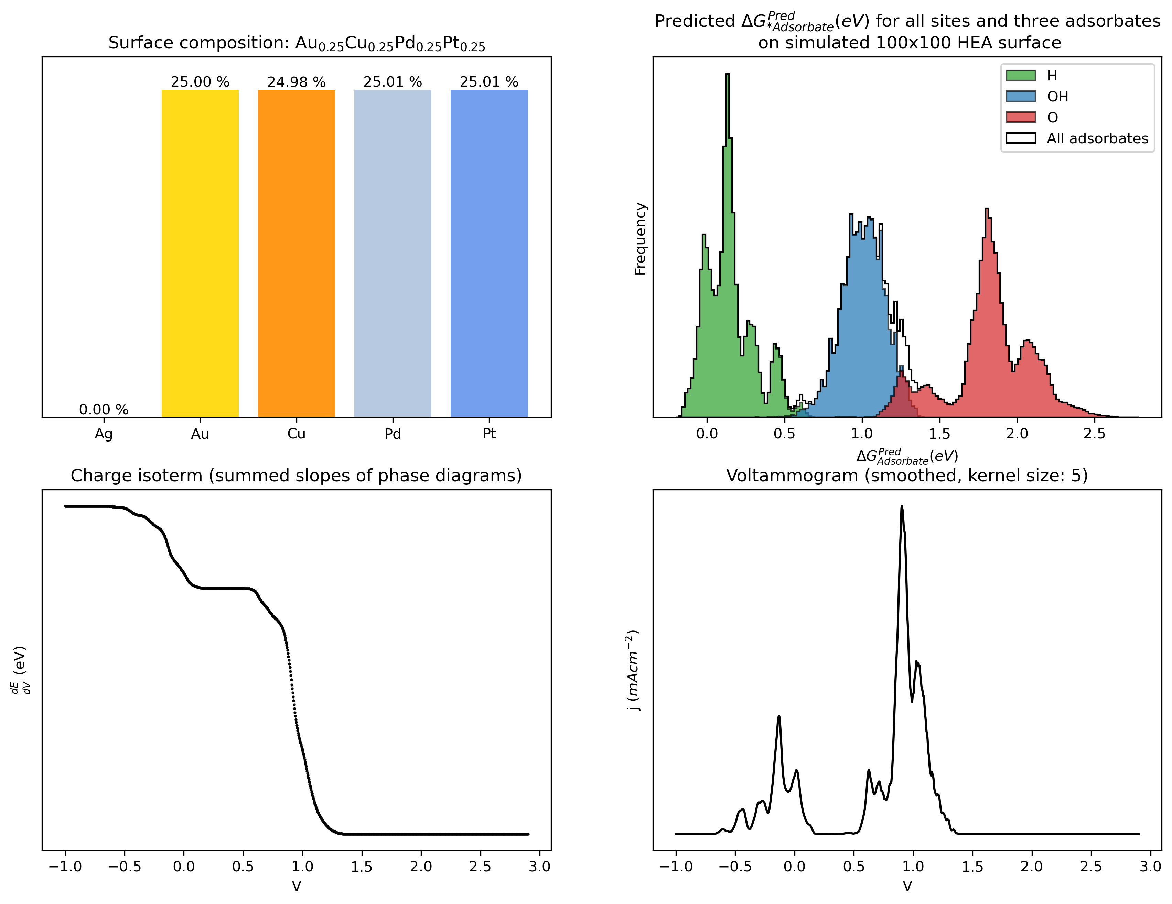
Results - Predicting energies of simulated surfaces

Slide 27
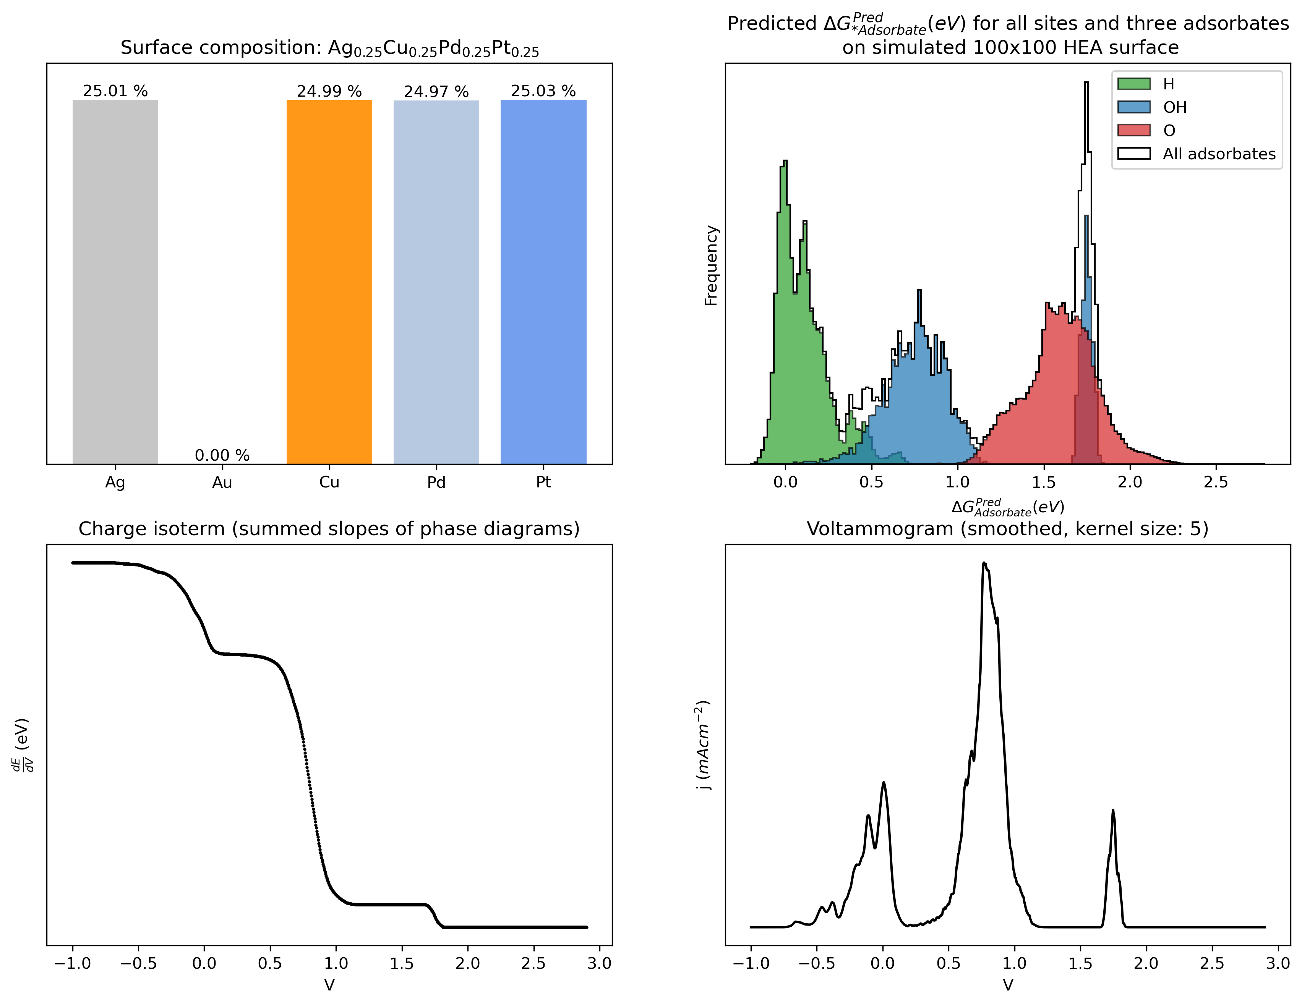
Results - Predicting energies of simulated surfaces

Slide 28
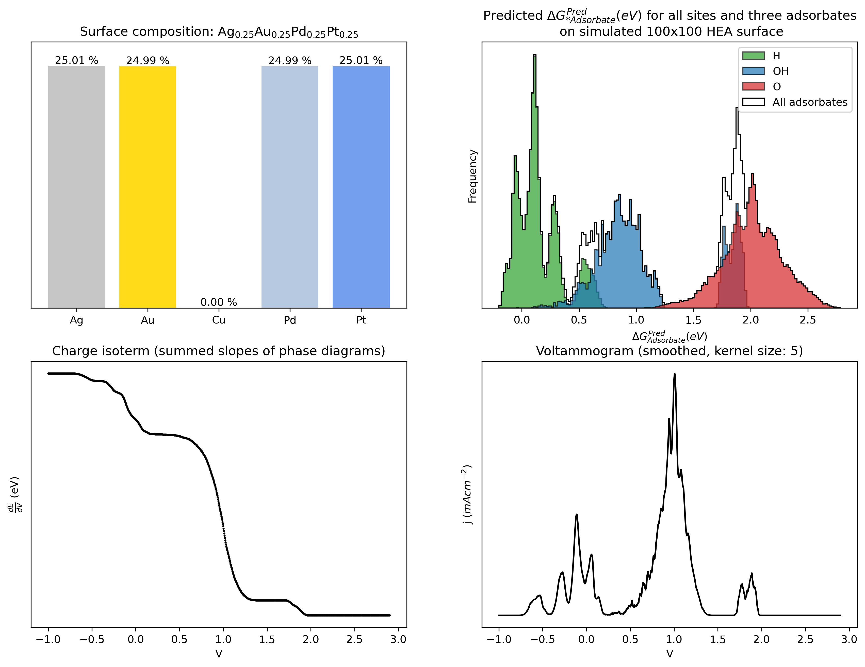
Results - Predicting energies of simulated surfaces

Slide 29
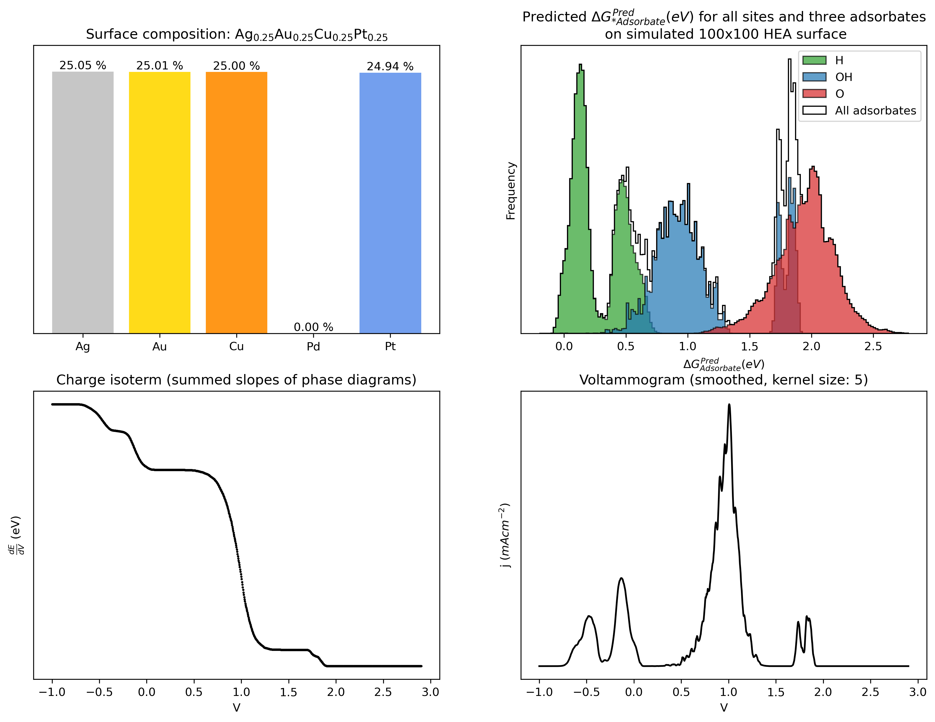
Results - Predicting energies of simulated surfaces

Slide 30
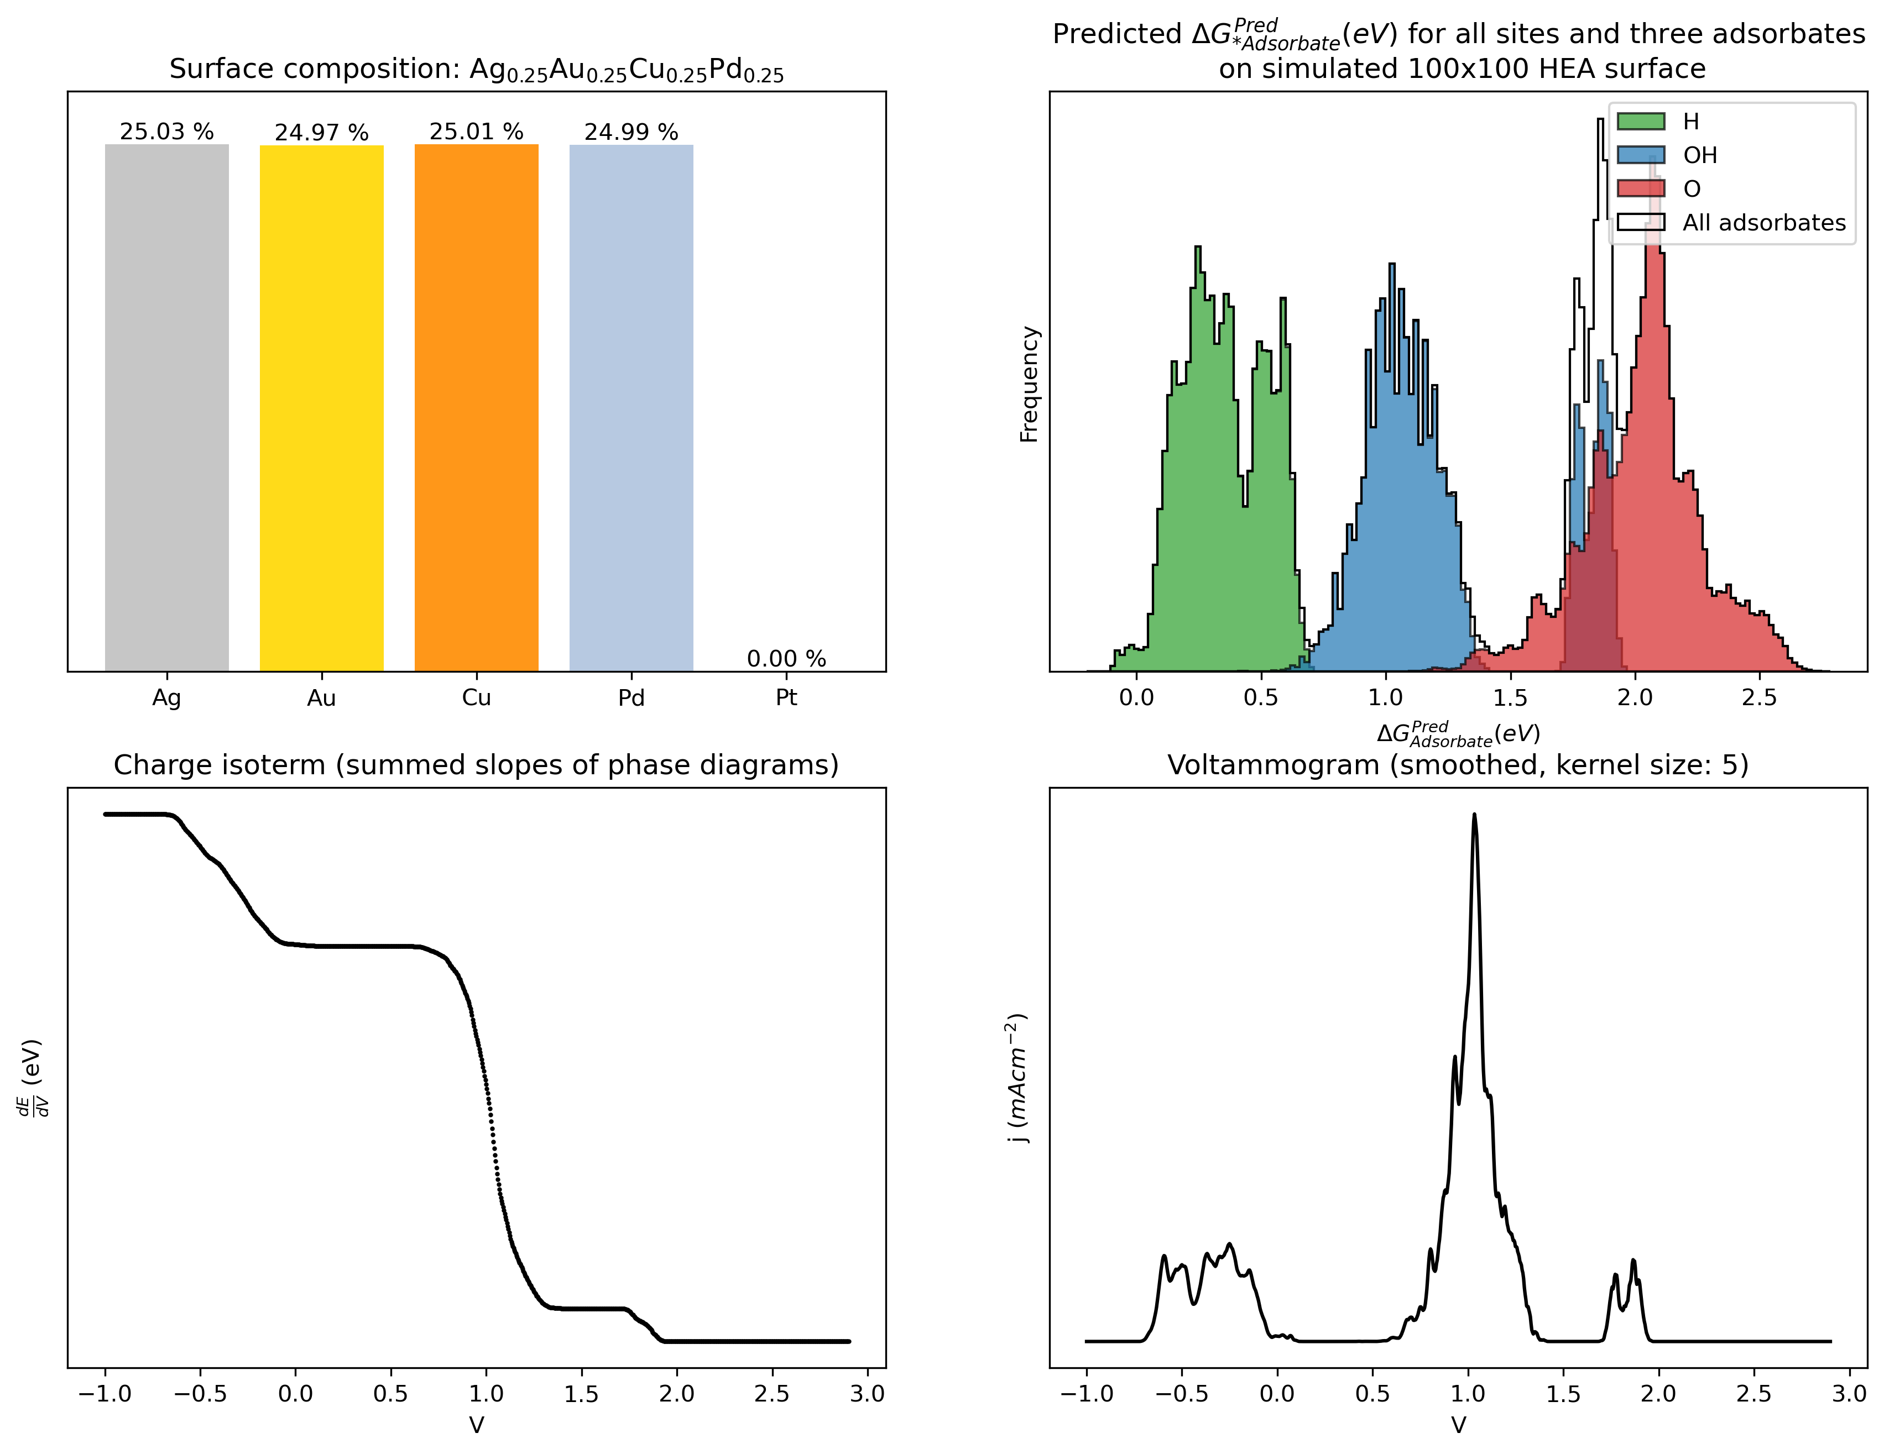
Results - Predicting energies of simulated surfaces

Slide 31
Results - Surface binding energies to voltammogram

Slide 32
Results - Surface binding energies to voltammogram

Slide 33
Results - Surface binding energies to voltammogram

Slide 34
Results - Surface binding energies to voltammogram

Slide 35
Results - Surface binding energies to voltammogram

Slide 36
Results - Surface binding energies to voltammogram

Slide 37
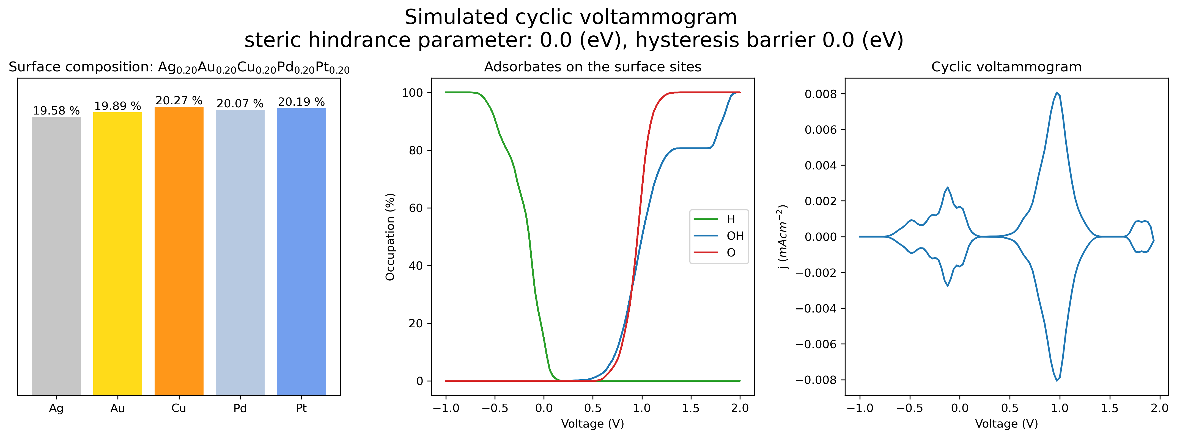
Results: Simulating surface adsorbates while varying voltage

Slide 38
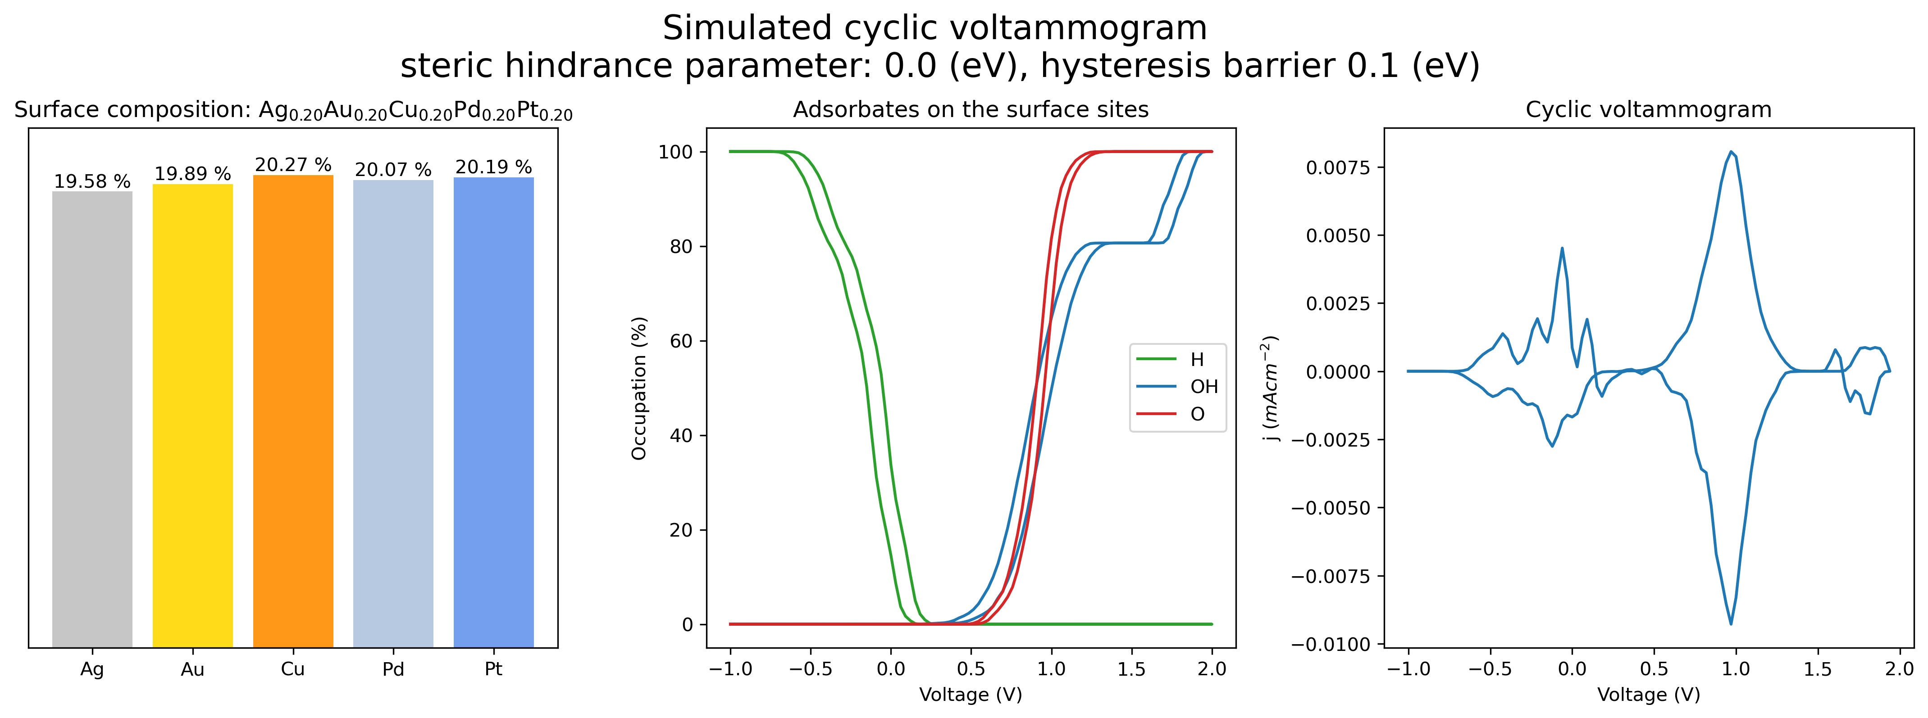
Results: Simulating surface adsorbates while varying voltage

Slide 39
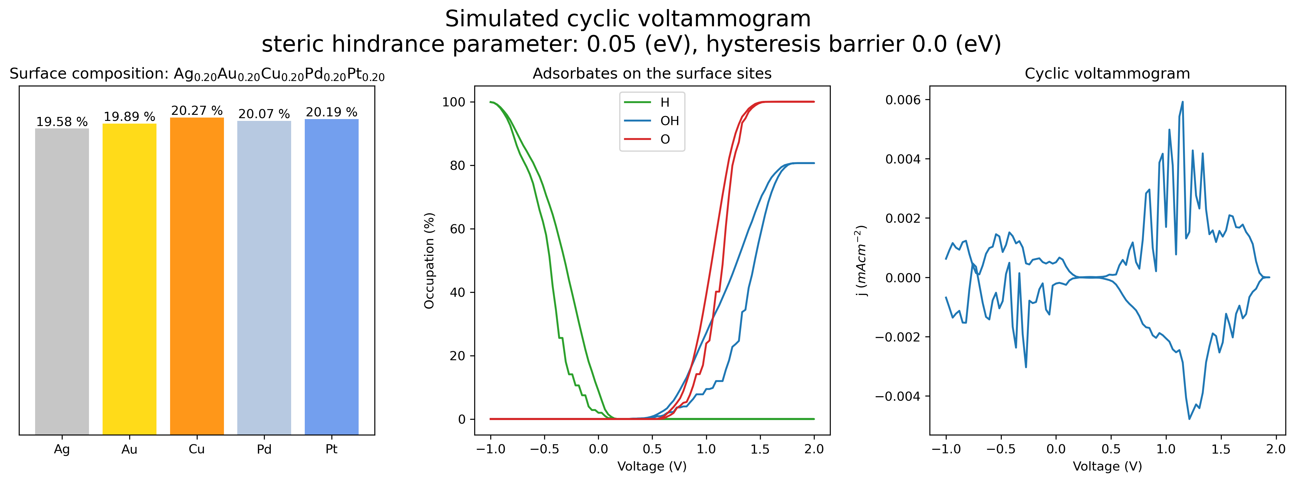
Results: Simulating surface adsorbates while varying voltage

Slide 40
Oversigt
Introduction
Reactions
DFT training data
Methods
Predicting binding energies
Predicting energies of simulated surfaces
Surface binding energies to voltammogram
Simulating surface adsorbates while varying voltage
Modeling neighbour-interactions
Modeling hysteresis
Results
Predicting binding energies of adsorbates
Predicting energies of simulated surfaces
Surface binding energies to voltammogram
Simulating surface adsorbates while varying voltage
Conclusion

Slide 41
Conclusion
Energy prediction models
Good
Seemingly easy task
Good performance
Useable on custom surfaces
Bad
Lacking in data of bimetals/trimetals
Voltammograms from energies
Good
Useable on custom surfaces
Bad
Does not account for hysteresis or neighbour-effects
Cyclic voltammograms
Good
Results match previous method
Keeps track of adsorbates
Shows occupancy for analysis
Tuneable hysteresis
Tuneable neighbour-effects
Bad
Questionable results from hysteresis + neighbour

Slide 42
Further work
Energy prediction models
Improvements:
More data
More metals
More datapoints
Other feature vectors
Graph-based regression algorithms
Voltammograms from energies
Improvements
Understand results
Could be used to track peaks when moving around in composition space
Fast renders -> Exploration of composition space
Cyclic voltammograms
Improvements
Fix hysteresis
Fix the neighbour-interactions
Implement other neighbour-interaction models (empirical-based)
Model other real world effects to get closer to real world voltammograms
Tune parameters to fit CV to experimental CVs

Slide 43
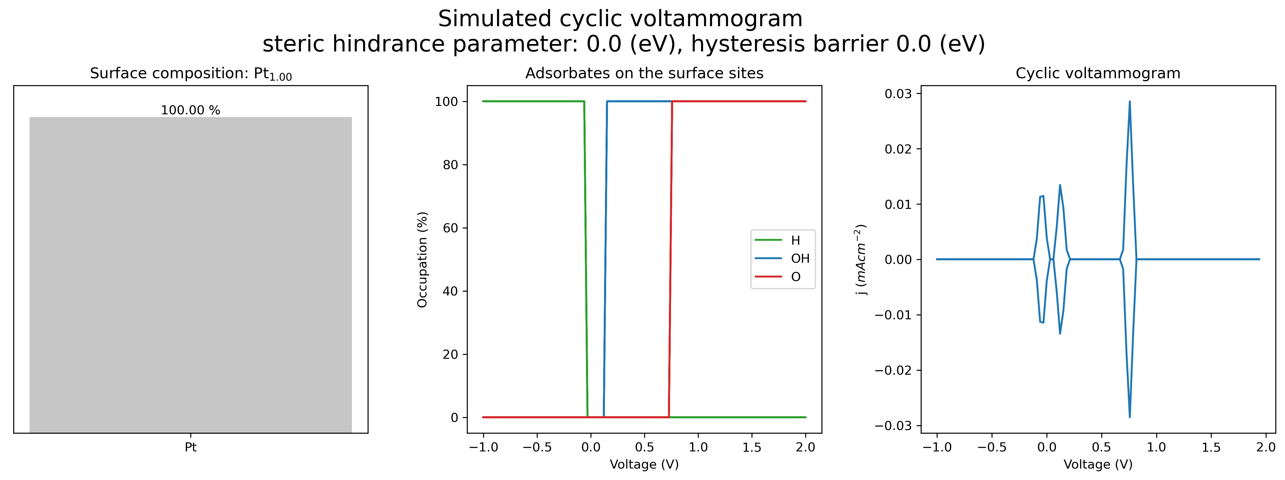
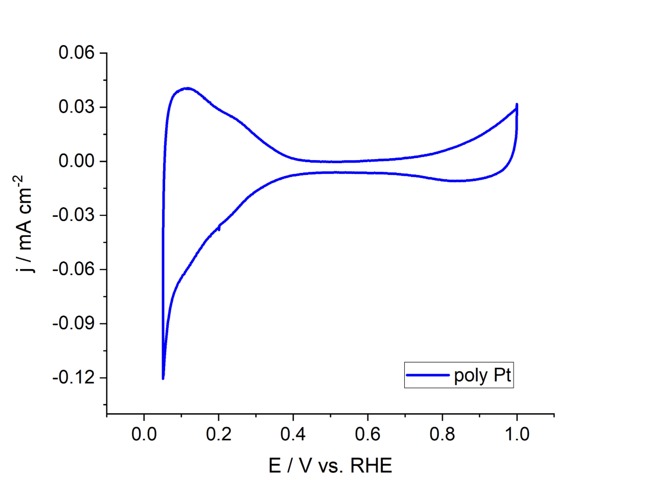
Comparison to experimental CV
Experimental CV
Source: María Paula Salinas Quezada

